Slide 1

Semantic analysis of Luxembourg company acts & other public information
BOUHAFRA Ouafae
MEHTA Anshul
SARKAR Swayam

Slide 2
Agenda
Objectives
High level design
Data extraction & preparation
Data sampling
Data accuracy & limitations
Data visualization
Future works
Questions

Slide 3
Objectives
Comparing companies on key parameters
Matching concepts and entities
Visualization by clustering
Identifying similarities and relationships

Slide 4
High level design
Gephi input data
Gephi Output
Corporate objects CSV file
Input PDF files
Input text files
Python Block
Master CSV file
Transformation Block
Cleaned Master data
Exception text file
Tableau input data
Tableau Output

Slide 5
Data extraction & preparation
Input text files
Extraction Module
Output CSV
Data Preparation
Numero RCS
Publication Reference
Date
Company name
Corporate object
Employee name
Tags
Output variables
CSV to Excel file
(UTF-8)
Drop columns
Install packages
Corporate object
Wide to long data
Corporate objects CSV
Main Module
Read files
Exception Module
NLP Module
To Gephi
Exception text file
Tag list
Transformed data Excel file
NLP trainer
To Tableau
NLP Trainer Module
Manually set tags
EN, DE, FR models
Stop words, Lemmatisation
150 noun tokens

Slide 6
Data sampling
Population size: 10746
Sample size: 635 (5.9%)
Exception size: 8
Actual sample size: 627

Slide 7
Data accuracy & limitations
Variable | Extraction % ( of 635) | Accuracy %*
Numero_RCS | 98.7 | 99.6
Publication | 98.7 | 99.5
Date | 98.7 | 100
Company Name | 98.7 | 98.8
Address | 76.5 | 99.7
Tags | 72.1 | 100
Employees | 73.22 | 100
* Accuracy obtained through eyeballing. Ignoring leading / trailing characters
Missing information during pdf to txt conversions
Some data has leading or trailing characters
Additional Excel block for transformation
Manual selection of tags from trainer data

Slide 8
Data visualization: Gephi
Please refer to Gephi software

Slide 9
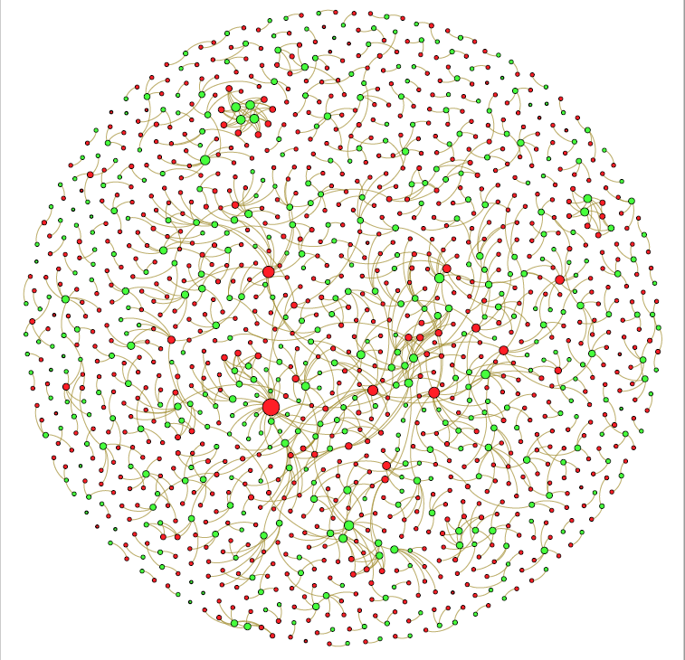
Network universe: Employees (red) & companies (green). Node size set by number of connections. Fruchterman Reingold layout.

Slide 10
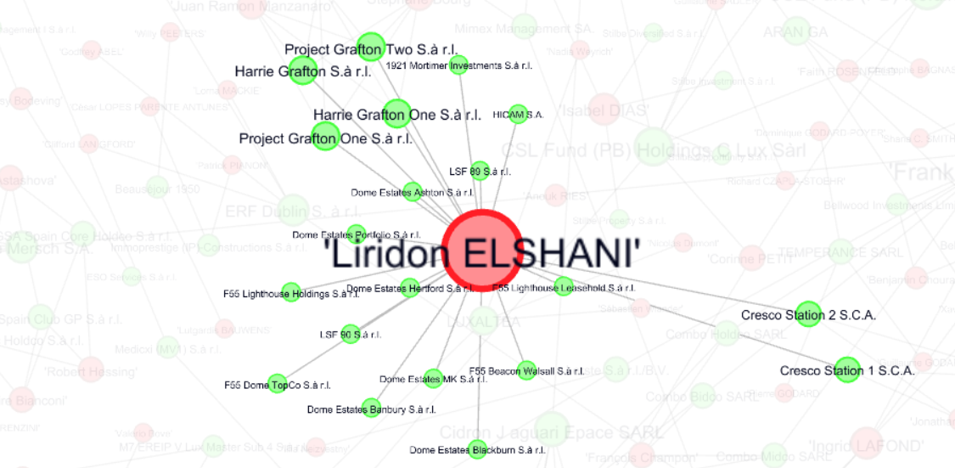
Employee connected to multiple companies

Slide 11
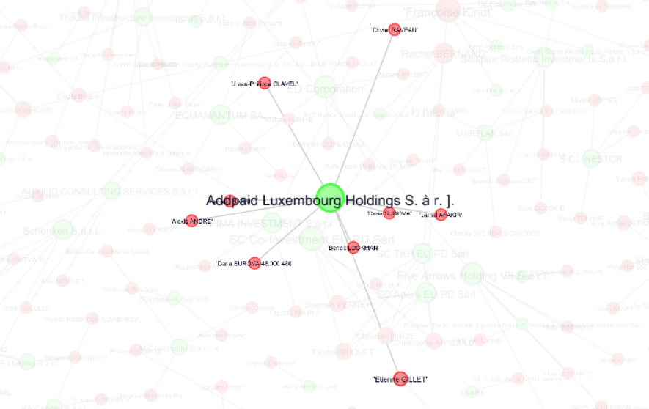
Company connected to multiple employees

Slide 12
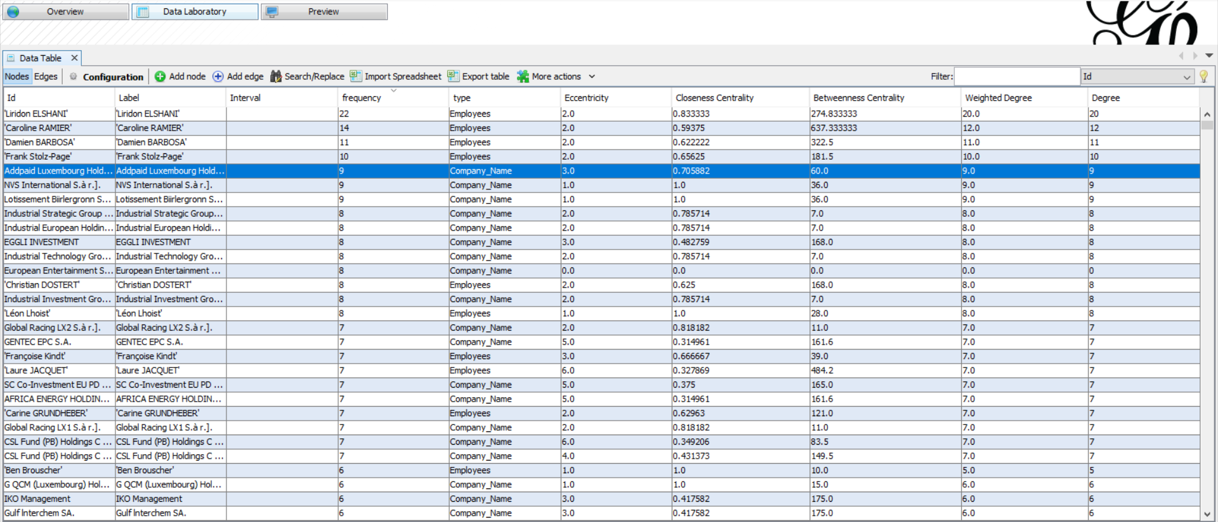
Data laboratory tab for identifying parameters & statistical analysis

Slide 13
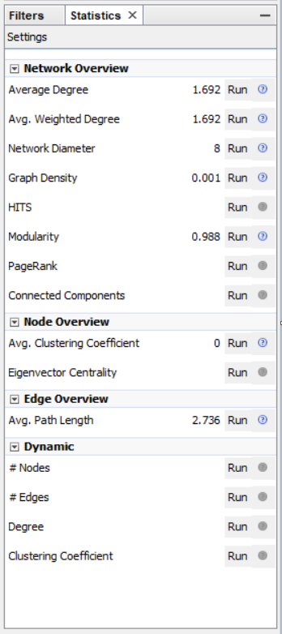
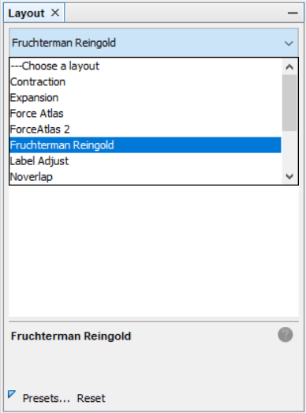
Select graph layout
Running statistical tests

Slide 14
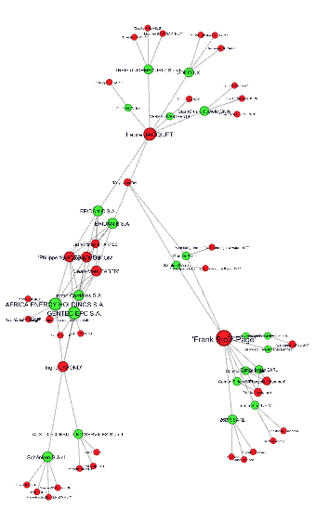
Running the Yifan Hu layout followed by the Noverlap layout isolates all connected nodes & subnodes as a cluster

Slide 15
Data visualization: Tableau
Please refer to Tableau software

Slide 16
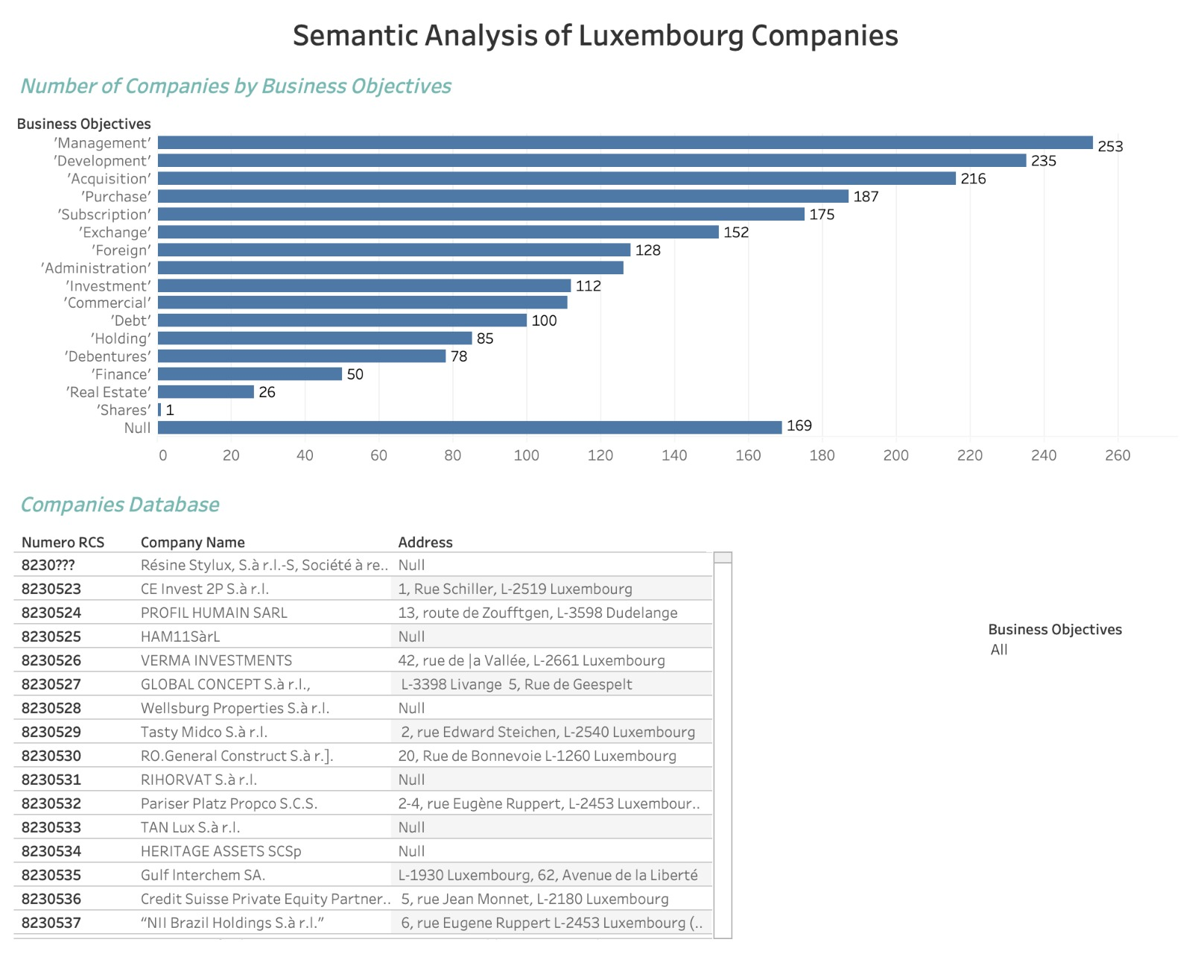

Slide 17
Future works
Tableau:
Company intersection with respect to 2 or many objective tags
Analysis of sister companies by comparing addresses and employees
Gephi:
Weighted nodes to employees / companies for further analysis
Node clustering by density - more sub connections
Finding the density of the network
Lost connections impact analysis

Slide 18

Questions

